Slide 1

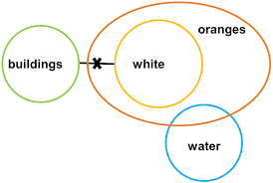
LOGICAL REASONING
SYLLOGISM

Slide 2
LOGICAL REASONING
SYLLOGISM
What is Syllogism?
The word syllogism is derived from the Greek word “syllogismos” which means “conclusion, inference”. Syllogisms are a logical argument of statements using deductive reasoning to arrive at a conclusion. The major contribution to the filed of syllogisms is attributed to Aristotle.
The questions which are asked in this section contain two or more statements, and two or more conclusions follow these statements. One has to find out which of these conclusions logically follow the given statements. The statements have to be taken true even if they seem to be at variance from the commonly known facts

Slide 3
LOGICAL REASONING
SYLLOGISM
The questions of syllogisms of three main parts.
Major premise
Minor premise
Conclusion
The central premise is a statement in general, believed to be true by the author.
Example: All women are smart.
The minor premise is a specific example of the major premise.
Example: Nisha is a woman.
The conclusion is a specific statement which logically follows both major and minor statement.
Example: Nisha is smart.
Application of Venn diagrams

Slide 4
LOGICAL REASONING
SYLLOGISM
Some more example:-
Major premise | Minor premise | Conclusion | Conclusion True/false
All dogs are cats. | All cats are bulls. | All bulls are dogs. | False(it’s true only according to 3rd case)
All dogs are cats. | All cats are bulls. | All dogs are bulls. | It’s true( In all the

Slide 5
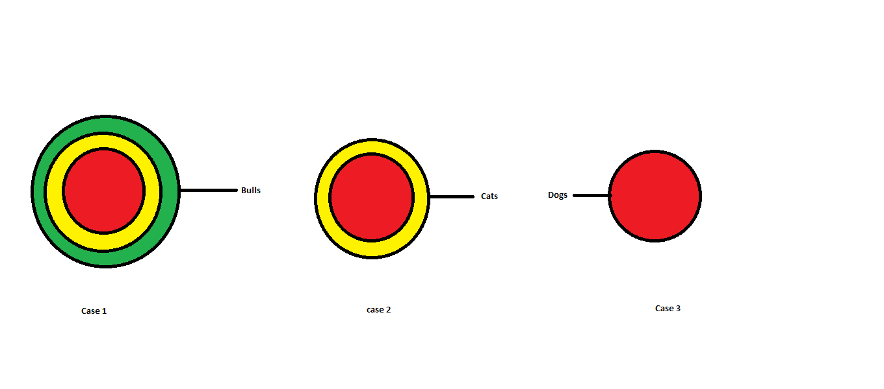
LOGICAL REASONING
SYLLOGISM
Note:- The conclusion should be true according to all the possible cases. One should draw all possible cases before arriving at a conclusion. Below the table that provides that correct combination of Venn diagrams of major and minor premises

Slide 6
SYLLOGISM
Types of statements:
There are four types of statements in syllogism
1. All
2. Some
3. No
4. Some not
These statements can be represented will the help of Venn diagram

Slide 7
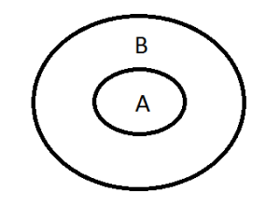
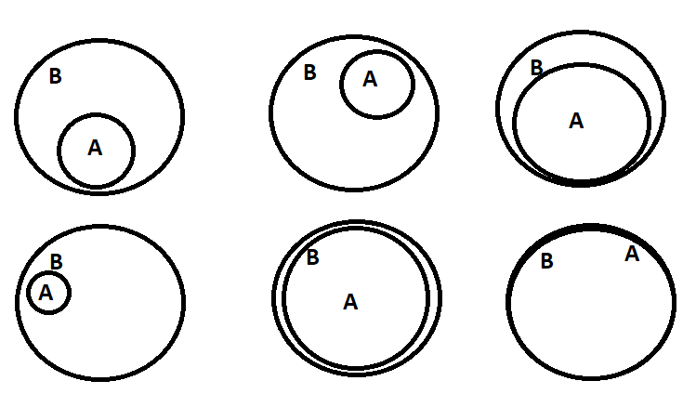
1.) All STATEMENT
All statement is written in the format “ALL A are B”, here A and B represent the subject and object of the statement.
Venn diagram

Slide 8
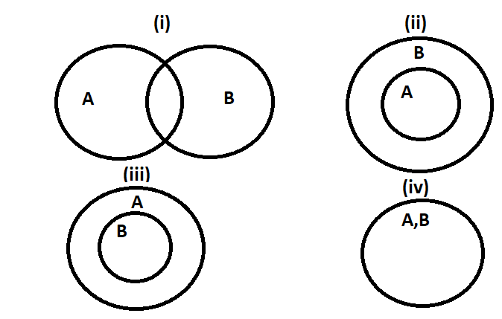
2.) SOME STATEMENT
Some statement is written in the format “Some A are B”, here A and B represent the subject and object of the statement.

Slide 9
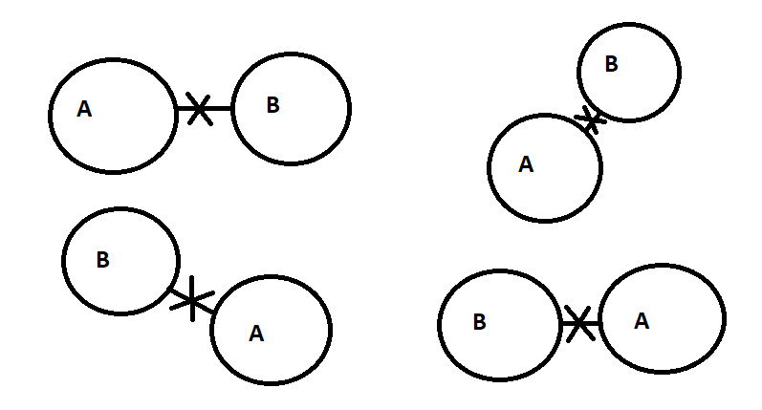
3.) NO STATEMENT
No statement is written in the format “No A are B”, here A and B represent the subject and object of the statement

Slide 10
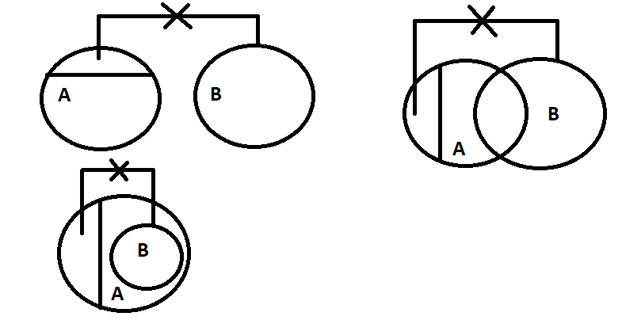
4.) SOME NOT STATEMENT
All statement is written in the format “Some A are not B”, here A and B represent the subject and object of the statement.

Slide 12
LOGICAL REASONING
SYLLOGISM
Directions: In each of the questions below are given two statements followed by two conclusions numbered I and II. You have to take the given statements to be true even if they seem to at variance from commonly known facts. Read all the conclusions and then decide which of the given conclusions logically follows from the given statements disregarding commonly known facts. Give answer:
if only Conclusion I follows. (2) if only Conclusion II follows.
(3) if either Conclusion I or II follows. (4) if neither Conclusion I nor II follows.
(5) if both Conclusions I and II follow.
Q 1.
Statements: Some kites are threads.
No thread is needle.
Conclusions: I. Some kites are needles.
II. No needle is thread.

Slide 13
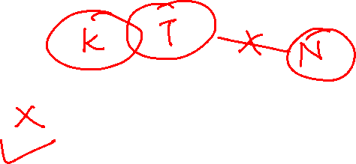
LOGICAL REASONING
SYLLOGISM
Directions: In each of the questions below are given two statements followed by two conclusions numbered I and II. You have to take the given statements to be true even if they seem to at variance from commonly known facts. Read all the conclusions and then decide which of the given conclusions logically follows from the given statements disregarding commonly known facts. Give answer:
if only Conclusion I follows. (2) if only Conclusion II follows.
(3) if either Conclusion I or II follows. (4) if neither Conclusion I nor II follows.
(5) if both Conclusions I and II follow.
Q 1.
Statements: Some kites are threads.
No thread is needle.
Conclusions: I. Some kites are needles.
II. No needle is thread.

Slide 14
LOGICAL REASONING
SYLLOGISM
Directions: In each of the questions below are given two statements followed by two conclusions numbered I and II. You have to take the given statements to be true even if they seem to at variance from commonly known facts. Read all the conclusions and then decide which of the given conclusions logically follows from the given statements disregarding commonly known facts. Give answer:
if only Conclusion I follows. (2) if only Conclusion II follows.
(3) if either Conclusion I or II follows. (4) if neither Conclusion I nor II follows.
(5) if both Conclusions I and II follow.
Q 2. Statements: Some trucks are houses.
Some houses are trains.
Conclusions: I. Some trains are trucks.
II. No train is truck.

Slide 15

LOGICAL REASONING
SYLLOGISM
Directions: In each of the questions below are given two statements followed by two conclusions numbered I and II. You have to take the given statements to be true even if they seem to at variance from commonly known facts. Read all the conclusions and then decide which of the given conclusions logically follows from the given statements disregarding commonly known facts. Give answer:
if only Conclusion I follows. (2) if only Conclusion II follows.
(3) if either Conclusion I or II follows. (4) if neither Conclusion I nor II follows.
(5) if both Conclusions I and II follow.
Q 2. Statements: Some trucks are houses.
Some houses are trains.
Conclusions: I. Some trains are trucks.
II. No train is truck.

Slide 16
LOGICAL REASONING
SYLLOGISM
Directions: In each of the questions below are given two statements followed by two conclusions numbered I and II. You have to take the given statements to be true even if they seem to at variance from commonly known facts. Read all the conclusions and then decide which of the given conclusions logically follows from the given statements disregarding commonly known facts. Give answer:
if only Conclusion I follows. (2) if only Conclusion II follows.
(3) if either Conclusion I or II follows. (4) if neither Conclusion I nor II follows.
(5) if both Conclusions I and II follow.
Q 3. Statements: All flowers are trees.
All trees are fruits.
Conclusions: I. Some fruits are flowers.
II. All flowers are fruits.

Slide 17
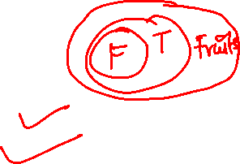
LOGICAL REASONING
SYLLOGISM
Directions: In each of the questions below are given two statements followed by two conclusions numbered I and II. You have to take the given statements to be true even if they seem to at variance from commonly known facts. Read all the conclusions and then decide which of the given conclusions logically follows from the given statements disregarding commonly known facts. Give answer:
if only Conclusion I follows. (2) if only Conclusion II follows.
(3) if either Conclusion I or II follows. (4) if neither Conclusion I nor II follows.
(5) if both Conclusions I and II follow.
Q 3. Statements: All flowers are trees.
All trees are fruits.
Conclusions: I. Some fruits are flowers.
II. All flowers are fruits.

Slide 18
LOGICAL REASONING
SYLLOGISM
Directions: In each of the questions below are given two statements followed by two conclusions numbered I and II. You have to take the given statements to be true even if they seem to at variance from commonly known facts. Read all the conclusions and then decide which of the given conclusions logically follows from the given statements disregarding commonly known facts. Give answer:
(1) if only Conclusion I follows. (2) if only Conclusion II follows.
(3) if either Conclusion I or II follows. (4) if neither Conclusion I nor II follows.
(5) if both Conclusions I and II follow.
Q 4. Statements: Some books are bags.
All bags are trees.
Conclusions: I. Some books are trees.
II. Some frees are books.

Slide 19

LOGICAL REASONING
SYLLOGISM
Directions: In each of the questions below are given two statements followed by two conclusions numbered I and II. You have to take the given statements to be true even if they seem to at variance from commonly known facts. Read all the conclusions and then decide which of the given conclusions logically follows from the given statements disregarding commonly known facts. Give answer:
(1) if only Conclusion I follows. (2) if only Conclusion II follows.
(3) if either Conclusion I or II follows. (4) if neither Conclusion I nor II follows.
(5) if both Conclusions I and II follow.
Q 4. Statements: Some books are bags.
All bags are trees.
Conclusions: I. Some books are trees.
II. Some frees are books.

Slide 20
LOGICAL REASONING
SYLLOGISM
Directions: In each of the questions below are given two statements followed by two conclusions numbered I and II. You have to take the given statements to be true even if they seem to at variance from commonly known facts. Read all the conclusions and then decide which of the given conclusions logically follows from the given statements disregarding commonly known facts. Give answer:
(1) if only Conclusion I follows. (2) if only Conclusion II follows.
(3) if either Conclusion I or II follows. (4) if neither Conclusion I nor II follows.
(5) if both Conclusions I and II follow.
Q 5. Statements: Some windows are doors.
No door is chair.
Conclusions: I. Some windows are chairs.
II. All doors are windows.

Slide 21
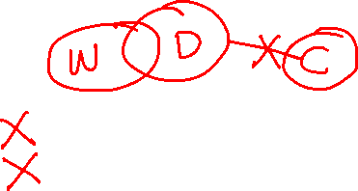
LOGICAL REASONING
SYLLOGISM
Directions: In each of the questions below are given two statements followed by two conclusions numbered I and II. You have to take the given statements to be true even if they seem to at variance from commonly known facts. Read all the conclusions and then decide which of the given conclusions logically follows from the given statements disregarding commonly known facts. Give answer:
(1) if only Conclusion I follows. (2) if only Conclusion II follows.
(3) if either Conclusion I or II follows. (4) if neither Conclusion I nor II follows.
(5) if both Conclusions I and II follow.
Q 5. Statements: Some windows are doors.
No door is chair.
Conclusions: I. Some windows are chairs.
II. All doors are windows.

Slide 22
LOGICAL REASONING
SYLLOGISM
Directions: In each of the questions below are given two statements followed by two conclusions numbered I and II. You have to take the given statements to be true even if they seem to at variance from commonly known facts. Read all the conclusions and then decide which of the given conclusions logically follows from the given statements disregarding commonly known facts. Give answer:
(1) if only Conclusion I follows. (2) if only Conclusion II follows.
(3) if either Conclusion I or II follows. (4) if neither Conclusion I nor II follows.
(5) if both Conclusions I and II follow.
Q 6. Statements: All forests are figures.
Some figures are houses.
Conclusions: I. Some houses are forests.
II. No house is forest.

Slide 23
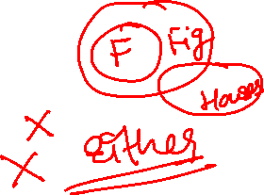
LOGICAL REASONING
SYLLOGISM
Directions: In each of the questions below are given two statements followed by two conclusions numbered I and II. You have to take the given statements to be true even if they seem to at variance from commonly known facts. Read all the conclusions and then decide which of the given conclusions logically follows from the given statements disregarding commonly known facts. Give answer:
(1) if only Conclusion I follows. (2) if only Conclusion II follows.
(3) if either Conclusion I or II follows. (4) if neither Conclusion I nor II follows.
(5) if both Conclusions I and II follow.
Q 6. Statements: All forests are figures.
Some figures are houses.
Conclusions: I. Some houses are forests.
II. No house is forest.

Slide 24
LOGICAL REASONING
SYLLOGISM
Directions: In each of the questions below are given two statements followed by two conclusions numbered I and II. You have to take the given statements to be true even if they seem to at variance from commonly known facts. Read all the conclusions and then decide which of the given conclusions logically follows from the given statements disregarding commonly known facts. Give answer:
(1) if only Conclusion I follows. (2) if only Conclusion II follows.
(3) if either Conclusion I or II follows. (4) if neither Conclusion I nor II follows.
(5) if both Conclusions I and II follow.
Q 7. Statements: Some buses are trains.
Some trains are boats.
Conclusions: I. Some trains are buses.
II. Some boats are buses.

Slide 25
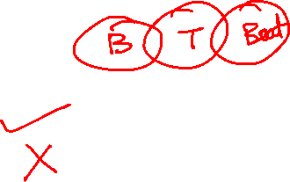
LOGICAL REASONING
SYLLOGISM
Directions: In each of the questions below are given two statements followed by two conclusions numbered I and II. You have to take the given statements to be true even if they seem to at variance from commonly known facts. Read all the conclusions and then decide which of the given conclusions logically follows from the given statements disregarding commonly known facts. Give answer:
(1) if only Conclusion I follows. (2) if only Conclusion II follows.
(3) if either Conclusion I or II follows. (4) if neither Conclusion I nor II follows.
(5) if both Conclusions I and II follow.
Q 7. Statements: Some buses are trains.
Some trains are boats.
Conclusions: I. Some trains are buses.
II. Some boats are buses.

Slide 26
LOGICAL REASONING
SYLLOGISM
Directions: In each of the questions below are given two statements followed by two conclusions numbered I and II. You have to take the given statements to be true even if they seem to at variance from commonly known facts. Read all the conclusions and then decide which of the given conclusions logically follows from the given statements disregarding commonly known facts. Give answer:
(1) if only Conclusion I follows. (2) if only Conclusion II follows.
(3) if either Conclusion I or II follows. (4) if neither Conclusion I nor II follows.
(5) if both Conclusions I and II follow.
Q 8. Statements: Some books are tables.
Some tables are mirrors.
Conclusions: I. Some mirrors are books.
II. No book is mirror.

Slide 27
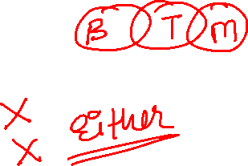
LOGICAL REASONING
SYLLOGISM
Directions: In each of the questions below are given two statements followed by two conclusions numbered I and II. You have to take the given statements to be true even if they seem to at variance from commonly known facts. Read all the conclusions and then decide which of the given conclusions logically follows from the given statements disregarding commonly known facts. Give answer:
(1) if only Conclusion I follows. (2) if only Conclusion II follows.
(3) if either Conclusion I or II follows. (4) if neither Conclusion I nor II follows.
(5) if both Conclusions I and II follow.
Q 8. Statements: Some books are tables.
Some tables are mirrors.
Conclusions: I. Some mirrors are books.
II. No book is mirror.

Slide 28
LOGICAL REASONING
SYLLOGISM
Directions: In each of the questions below are given two statements followed by two conclusions numbered I and II. You have to take the given statements to be true even if they seem to at variance from commonly known facts. Read all the conclusions and then decide which of the given conclusions logically follows from the given statements disregarding commonly known facts. Give answer:
(1) if only Conclusion I follows. (2) if only Conclusion II follows.
(3) if either Conclusion I or II follows. (4) if neither Conclusion I nor II follows.
(5) if both Conclusions I and II follow.
Q 9. Statements: All flowers are trees.
No fruit is tree.
Conclusions: I. No fruit is flower.
II. Some trees are flowers.

Slide 29
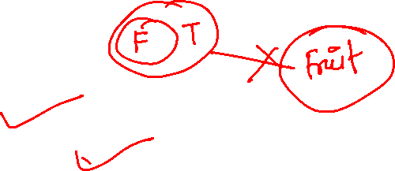
LOGICAL REASONING
SYLLOGISM
Directions: In each of the questions below are given two statements followed by two conclusions numbered I and II. You have to take the given statements to be true even if they seem to at variance from commonly known facts. Read all the conclusions and then decide which of the given conclusions logically follows from the given statements disregarding commonly known facts. Give answer:
(1) if only Conclusion I follows. (2) if only Conclusion II follows.
(3) if either Conclusion I or II follows. (4) if neither Conclusion I nor II follows.
(5) if both Conclusions I and II follow.
Q 9. Statements: All flowers are trees.
No fruit is tree.
Conclusions: I. No fruit is flower.
II. Some trees are flowers.

Slide 30
LOGICAL REASONING
SYLLOGISM
Directions: In each of the questions below are given two statements followed by two conclusions numbered I and II. You have to take the given statements to be true even if they seem to at variance from commonly known facts. Read all the conclusions and then decide which of the given conclusions logically follows from the given statements disregarding commonly known facts. Give answer:
(1) if only Conclusion I follows. (2) if only Conclusion II follows.
(3) if either Conclusion I or II follows. (4) if neither Conclusion I nor II follows.
(5) if both Conclusions I and II follow.
Q 10. Statements: All pens are chalks.
All chairs are chalks.
Conclusions: I. Some pens are chairs.
II. Some chalks are pens.

Slide 31
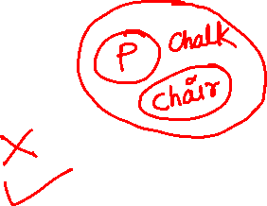
LOGICAL REASONING
SYLLOGISM
Directions: In each of the questions below are given two statements followed by two conclusions numbered I and II. You have to take the given statements to be true even if they seem to at variance from commonly known facts. Read all the conclusions and then decide which of the given conclusions logically follows from the given statements disregarding commonly known facts. Give answer:
(1) if only Conclusion I follows. (2) if only Conclusion II follows.
(3) if either Conclusion I or II follows. (4) if neither Conclusion I nor II follows.
(5) if both Conclusions I and II follow.
Q 10. Statements: All pens are chalks.
All chairs are chalks.
Conclusions: I. Some pens are chairs.
II. Some chalks are pens.

Slide 32
LOGICAL REASONING
SYLLOGISM
Directions: In each of the questions below are given two statements followed by two conclusions numbered I and II. You have to take the given statements to be true even if they seem to at variance from commonly known facts. Read all the conclusions and then decide which of the given conclusions logically follows from the given statements disregarding commonly known facts. Give answer:
(1) if only Conclusion I follows. (2) if only Conclusion II follows.
(3) if either Conclusion I or II follows. (4) if neither Conclusion I nor II follows.
(5) if both Conclusions I and II follow.
Q 11. Statements: Some buses are bells.
Some bells are horses.
All trains are horses.
Conclusions: I. Some buses are horses.
II. Some trains are bells.

Slide 33
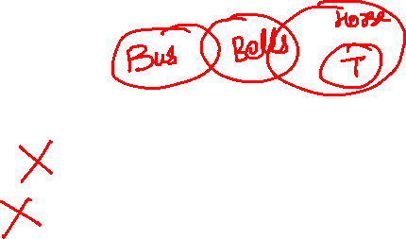
LOGICAL REASONING
SYLLOGISM
Directions: In each of the questions below are given two statements followed by two conclusions numbered I and II. You have to take the given statements to be true even if they seem to at variance from commonly known facts. Read all the conclusions and then decide which of the given conclusions logically follows from the given statements disregarding commonly known facts. Give answer:
(1) if only Conclusion I follows. (2) if only Conclusion II follows.
(3) if either Conclusion I or II follows. (4) if neither Conclusion I nor II follows.
(5) if both Conclusions I and II follow.
Q 11. Statements: Some buses are bells.
Some bells are horses.
All trains are horses.
Conclusions: I. Some buses are horses.
II. Some trains are bells.

Slide 34
LOGICAL REASONING
SYLLOGISM
Directions: In each of the questions below are given two statements followed by two conclusions numbered I and II. You have to take the given statements to be true even if they seem to at variance from commonly known facts. Read all the conclusions and then decide which of the given conclusions logically follows from the given statements disregarding commonly known facts. Give answer:
(1) if only Conclusion I follows. (2) if only Conclusion II follows.
(3) if either Conclusion I or II follows. (4) if neither Conclusion I nor II follows.
(5) if both Conclusions I and II follow.
Q 12. Statements: All classes are lions.
Some birds are classes.
All pens are lions.
Conclusions: I. No pen is bird.
II. Some birds are pens.

Slide 35
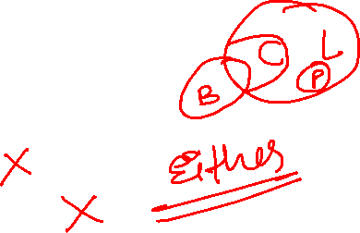
LOGICAL REASONING
SYLLOGISM
Directions: In each of the questions below are given two statements followed by two conclusions numbered I and II. You have to take the given statements to be true even if they seem to at variance from commonly known facts. Read all the conclusions and then decide which of the given conclusions logically follows from the given statements disregarding commonly known facts. Give answer:
(1) if only Conclusion I follows. (2) if only Conclusion II follows.
(3) if either Conclusion I or II follows. (4) if neither Conclusion I nor II follows.
(5) if both Conclusions I and II follow.
Q 12. Statements: All classes are lions.
Some birds are classes.
All pens are lions.
Conclusions: I. No pen is bird.
II. Some birds are pens.

Slide 36
LOGICAL REASONING
SYLLOGISM
Q 13. Statements: All petals are trees.
All trees are gardens.
All roads are gardens.
Conclusions: I. Some roads are trees.
II. Some gardens are trees.
III. Some gardens are petals.
Only I and II follow
(2) Only II and III follow
(3) Only I and III follow
(4) All I, II and III follow
(5) None of these

Slide 37
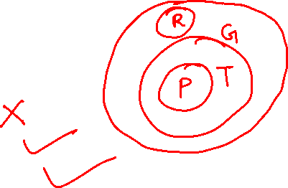
LOGICAL REASONING
SYLLOGISM
Q 13. Statements: All petals are trees.
All trees are gardens.
All roads are gardens.
Conclusions: I. Some roads are trees.
II. Some gardens are trees.
III. Some gardens are petals.
Only I and II follow
(2) Only II and III follow
(3) Only I and III follow
(4) All I, II and III follow
(5) None of these

Slide 38
LOGICAL REASONING
SYLLOGISM
Q 14. Statements: All keys are locks.
No lock is toy.
All bags are toys.
Conclusions: I. No bag is key.
II. Some bags are keys.
III. Some toys are keys.
None follows
(2) Only I follows
(3) Only II follows
(4) Only III follows
(5) Only I and II follow

Slide 39
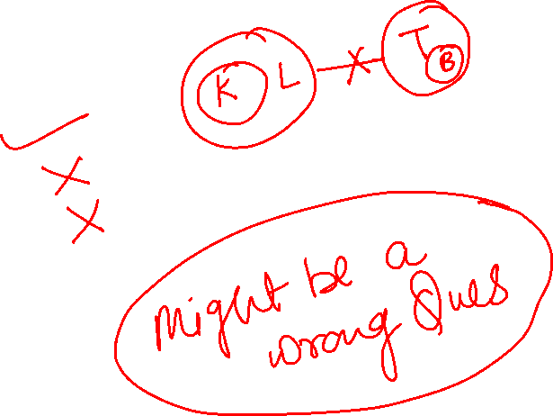
LOGICAL REASONING
SYLLOGISM
Q 14. Statements: All keys are locks.
No lock is toy.
All bags are toys.
Conclusions: I. No bag is key.
II. Some bags are keys.
III. Some toys are keys.
None follows
(2) Only I follows
(3) Only II follows
(4) Only III follows
(5) Only I and II follow

Slide 40
LOGICAL REASONING
SYLLOGISM
Q 15. Statements: Some days are nights.
Some nights are months.
Some months are years.
Conclusions: I. Some years are nights.
II. Some months are days.
III. No year is night.
Only I follows
(2) Only II follows
(3) Only III follows
(4) Only either I or III follows
(5) None of these

Slide 41

LOGICAL REASONING
SYLLOGISM
Q 15. Statements: Some days are nights.
Some nights are months.
Some months are years.
Conclusions: I. Some years are nights.
II. Some months are days.
III. No year is night.
Only I follows
(2) Only II follows
(3) Only III follows
(4) Only either I or III follows
(5) None of these

Slide 42
LOGICAL REASONING
SYLLOGISM
Q 16. Statements: All cycles are tyres.
Some tyres are wheels.
All wheels are buses.
Conclusions: I. Some buses are tyres.
II. Some wheels are tyres.
III. Some buses are cycles.
Only I and II follow
(2) Only I and III follow
(3) Only II and III follow
(4) All I, II and III follow
(5) None of these

Slide 43

LOGICAL REASONING
SYLLOGISM
Q 16. Statements: All cycles are tyres.
Some tyres are wheels.
All wheels are buses.
Conclusions: I. Some buses are tyres.
II. Some wheels are tyres.
III. Some buses are cycles.
Only I and II follow
(2) Only I and III follow
(3) Only II and III follow
(4) All I, II and III follow
(5) None of these

Slide 44
LOGICAL REASONING
SYLLOGISM
Q 17. Statements: Some dogs are cats.
Some cats are horses.
All horses are tigers.
Conclusions :I. Some tigers are cats.
II. Some horses are dogs.
III. Some tigers are dogs.
None follows
(2) Only I follows
(3) Only II follows
(4) Only III follows
(5) Only II and III follow

Slide 45
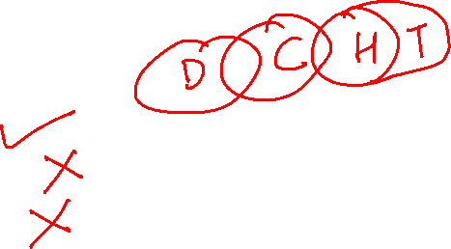
LOGICAL REASONING
SYLLOGISM
Q 17. Statements: Some dogs are cats.
Some cats are horses.
All horses are tigers.
Conclusions :I. Some tigers are cats.
II. Some horses are dogs.
III. Some tigers are dogs.
None follows
(2) Only I follows
(3) Only II follows
(4) Only III follows
(5) Only II and III follow

Slide 46
LOGICAL REASONING
SYLLOGISM
Q 18. Statements: Some leaves are baskets.
Some baskets are flowers.
Some flowers are lakes.
Conclusions: I. Some lakes are baskets.
II. Some flowers are lakes.
III. No lake is basket.
Only I follows
(2) Only II follows
(3) Only III follows
(4) Only either I or III follows
(5) None of these

Slide 47
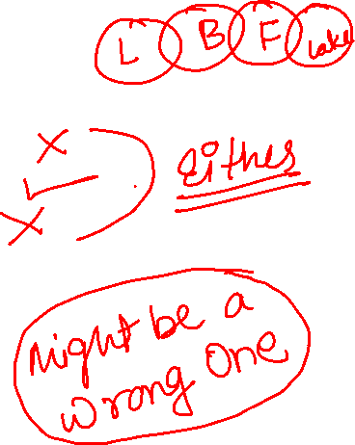


LOGICAL REASONING
SYLLOGISM
Q 18. Statements: Some leaves are baskets.
Some baskets are flowers.
Some flowers are lakes.
Conclusions: I. Some lakes are baskets.
II. Some flowers are lakes.
III. No lake is basket.
Only I follows
(2) Only II follows
(3) Only III follows
(4) Only either I or III follows
(5) None of these

Slide 48
LOGICAL REASONING
SYLLOGISM
Q 19. Statements: All pictures are bands.
Some bands are chairs.
Some chairs are tables.
Conclusions: I. Some tables are bands.
II. Some chairs are pictures.
III. Some tables are pictures.
None follows
(2) Only I follows
(3) Only II follows
(4) Only I and II follow
(5) Only III follows

Slide 49
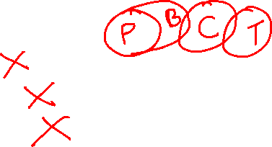
LOGICAL REASONING
SYLLOGISM
Q 19. Statements: All pictures are bands.
Some bands are chairs.
Some chairs are tables.
Conclusions: I. Some tables are bands.
II. Some chairs are pictures.
III. Some tables are pictures.
None follows
(2) Only I follows
(3) Only II follows
(4) Only I and II follow
(5) Only III follows

Slide 50
LOGICAL REASONING
SYLLOGISM
Q 20. Statements : Some bikes are cars.
Some cars are trains.
Some trains are buses.
Conclusions : I. Some buses are cars.
II. Some trains are bikes.
III. Some buses are bikes.
None follows
(2) Only I follows
(3) Only II follows
(4) Only III follows
(5) Only I and II follow

Slide 51
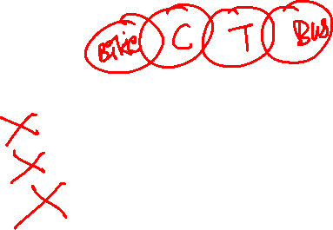
LOGICAL REASONING
SYLLOGISM
Q 20. Statements : Some bikes are cars.
Some cars are trains.
Some trains are buses.
Conclusions : I. Some buses are cars.
II. Some trains are bikes.
III. Some buses are bikes.
None follows
(2) Only I follows
(3) Only II follows
(4) Only III follows
(5) Only I and II follow

Slide 52
LOGICAL REASONING
SYLLOGISM
Q 21. Statements : All dogs are cats.
Some cats are rats.
All rats are mats.
Conclusions: I. Some mats are cats.
II. Some mats are dogs.
III. Some rats are cats.
Only I follows
(2) Only II follows
(3) Only III follows
(4) Only I and III follow
(5) None of these

Slide 53
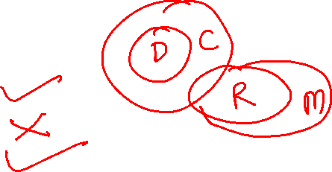
LOGICAL REASONING
SYLLOGISM
Q 21. Statements : All dogs are cats.
Some cats are rats.
All rats are mats.
Conclusions: I. Some mats are cats.
II. Some mats are dogs.
III. Some rats are cats.
Only I follows
(2) Only II follows
(3) Only III follows
(4) Only I and III follow
(5) None of these

Slide 54
LOGICAL REASONING
SYLLOGISM
Q 22. Statements: Some boxes are walls.
No wall is road.
All roads are rivers.
Conclusions: I. Some rivers are walls
II. Some roads are boxes
III. No wall is river
Only I follows
(2) Only either I or III follows
(3) Only III follows
(4) Only II follows
(5) Only II and III follow

Slide 55
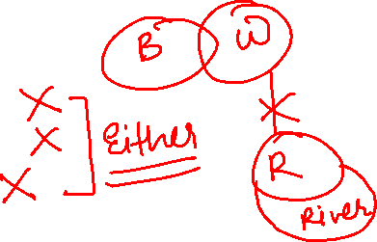
LOGICAL REASONING
SYLLOGISM
Q 22. Statements: Some boxes are walls.
No wall is road.
All roads are rivers.
Conclusions: I. Some rivers are walls
II. Some roads are boxes
III. No wall is river
Only I follows
(2) Only either I or III follows
(3) Only III follows
(4) Only II follows
(5) Only II and III follow

Slide 56
LOGICAL REASONING
SYLLOGISM
Q 23. Statements : Some tables are chairs.
All chairs are houses.
All houses are tents.
Conclusions: I. All houses are chairs.
II. Some tents are chairs.
III. Some houses are tables.
Only I and II follow
(2) Only I and III follow
(3) Only II and III follow
(4) All I, II and III follow
(5) None of these

Slide 57
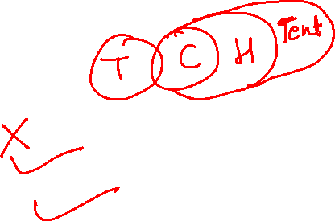
LOGICAL REASONING
SYLLOGISM
Q 23. Statements : Some tables are chairs.
All chairs are houses.
All houses are tents.
Conclusions: I. All houses are chairs.
II. Some tents are chairs.
III. Some houses are tables.
Only I and II follow
(2) Only I and III follow
(3) Only II and III follow
(4) All I, II and III follow
(5) None of these

Slide 58
LOGICAL REASONING
SYLLOGISM
Q 24. Statements : All pens are sticks.
All sticks are rings.
All rings are rods.
Conclusions : I. Some rings are pens.
II. Some rods are sticks.
III. Some rods are pens.
Only I and II follow
(2) Only I and III follow
(3) Only II and III follow
(4) All I, II and III follow
(5) None of these

Slide 59
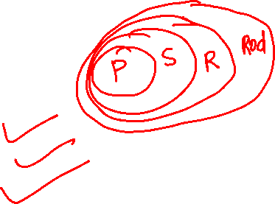
LOGICAL REASONING
SYLLOGISM
Q 24. Statements : All pens are sticks.
All sticks are rings.
All rings are rods.
Conclusions : I. Some rings are pens.
II. Some rods are sticks.
III. Some rods are pens.
Only I and II follow
(2) Only I and III follow
(3) Only II and III follow
(4) All I, II and III follow
(5) None of these

Slide 60
LOGICAL REASONING
SYLLOGISM
Q 25. Statements: Some nails are plates.
Some plates are disks.
All disks are mirrors.
All mirrors are tyres.
Conclusions: I. Some tyres are plates.
II. Some tyres are nails.
III. Some mirrors are plates.
Only I and II follow
(2) Only I and III follow
(3) Only II and III follow
(4) All I, II and III follow
(5) None of these

Slide 61
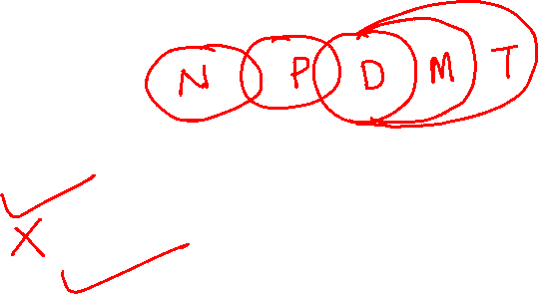
LOGICAL REASONING
SYLLOGISM
Q 25. Statements: Some nails are plates.
Some plates are disks.
All disks are mirrors.
All mirrors are tyres.
Conclusions: I. Some tyres are plates.
II. Some tyres are nails.
III. Some mirrors are plates.
Only I and II follow
(2) Only I and III follow
(3) Only II and III follow
(4) All I, II and III follow
(5) None of these

Slide 62
LOGICAL REASONING
SYLLOGISM
Q 26. Statements: Some beads are chairs.
All chairs are trucks.
Some trucks are bricks.
All bricks are cars.
Conclusions: I. Some cars are chairs.
II. Some cars are trucks.
III. Some trucks are beads.
Only I and II follow
(2) Only I and III follow
(3) Only II and III follow
(4) All I, II and III follow
(5) None of these

Slide 63
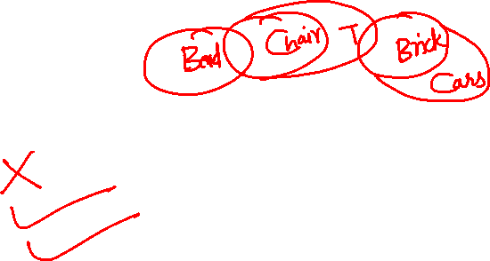
LOGICAL REASONING
SYLLOGISM
Q 26. Statements: Some beads are chairs.
All chairs are trucks.
Some trucks are bricks.
All bricks are cars.
Conclusions: I. Some cars are chairs.
II. Some cars are trucks.
III. Some trucks are beads.
Only I and II follow
(2) Only I and III follow
(3) Only II and III follow
(4) All I, II and III follow
(5) None of these

Slide 64
LOGICAL REASONING
SYLLOGISM
Q 27. Statements: All shirts are hats.
No hat is suit. Some rings are suits.
All rings are bangles.
Conclusions: I. Some rings are hats.
II. Some bangles are suits.
III. No ring is hat.
Only I follows
(2) Only II follows
(3) Only III follows
(4) Only either I or III follows
(5) Only either I or III and II follow

Slide 65
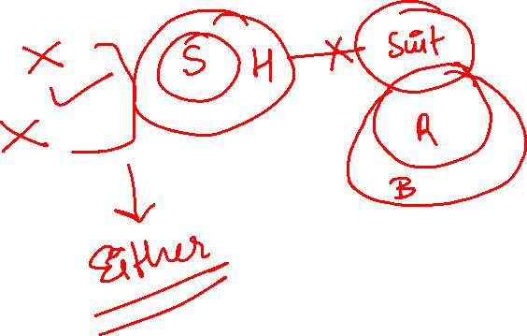
LOGICAL REASONING
SYLLOGISM
Q 27. Statements: All shirts are hats.
No hat is suit. Some rings are suits.
All rings are bangles.
Conclusions: I. Some rings are hats.
II. Some bangles are suits.
III. No ring is hat.
Only I follows
(2) Only II follows
(3) Only III follows
(4) Only either I or III follows
(5) Only either I or III and II follow

Slide 66
LOGICAL REASONING
SYLLOGISM
Q 28. Statements: Some skies are rains.
Some rains are stars.
All stars are planets.
All planets are clouds.
Conclusions: I. Some clouds are rains.
II. Some planets are skies.
III. Some planets are rains.
Only I and II follow
(2) Only I and III follow
(3) Only II and III follow
(4) All I, II and III follow
(5) None of these

Slide 67
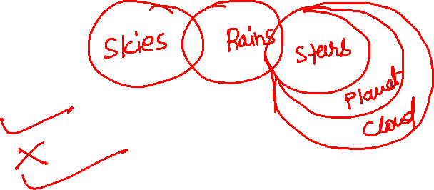
LOGICAL REASONING
SYLLOGISM
Q 28. Statements: Some skies are rains.
Some rains are stars.
All stars are planets.
All planets are clouds.
Conclusions: I. Some clouds are rains.
II. Some planets are skies.
III. Some planets are rains.
Only I and II follow
(2) Only I and III follow
(3) Only II and III follow
(4) All I, II and III follow
(5) None of these

Slide 68
LOGICAL REASONING
SYLLOGISM
Q 29. Statements: All birds are goats.
No goat is flower.
Some flowers are mountains.
Some mountains are nets.
Conclusions: I. Some nets are goats.
II. No net is goat.
III. Some mountains are birds.
None follows
(2) Only I follows
(3) Only either I or II follows
(4) Only II follows
(5) Only III follows

Slide 69
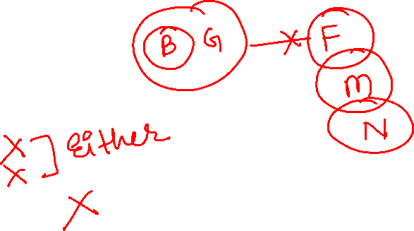
LOGICAL REASONING
SYLLOGISM
Q 29. Statements: All birds are goats.
No goat is flower.
Some flowers are mountains.
Some mountains are nets.
Conclusions: I. Some nets are goats.
II. No net is goat.
III. Some mountains are birds.
None follows
(2) Only I follows
(3) Only either I or II follows
(4) Only II follows
(5) Only III follows

Slide 70
LOGICAL REASONING
SYLLOGISM
Q 30. Statements: Some leaves are skies.
All skies are clouds.
No cloud is a boat.
Conclusions: I. Some boats are leaves.
II. Some clouds are leaves.
III. All skies are leaves.
IV. No leaf is a boat.
Only I, II and IV follow
(2) Only II, III and IV follow
(3) Either I or IV and II follow
(4) Either I or IV and III follow
(5) None of these

Slide 71
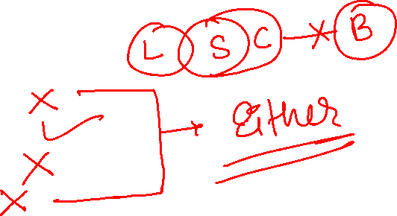
LOGICAL REASONING
SYLLOGISM
Q 30. Statements: Some leaves are skies.
All skies are clouds.
No cloud is a boat.
Conclusions: I. Some boats are leaves.
II. Some clouds are leaves.
III. All skies are leaves.
IV. No leaf is a boat.
Only I, II and IV follow
(2) Only II, III and IV follow
(3) Either I or IV and II follow
(4) Either I or IV and III follow
(5) None of these

Slide 72
LOGICAL REASONING
SYLLOGISM
Q 31. Statements: No building is white.
All whites are oranges.
Some oranges are waters.
Conclusions: I. No building is water.
II. No orange is a building.
III. Some oranges are whites.
IV. Some waters are building.
Either I or IV and II follow
(2) Either I or IV and III follow
(3) Either I or IV follows
(4) None follows
(5) Either I or IV and II and III follow

Slide 73
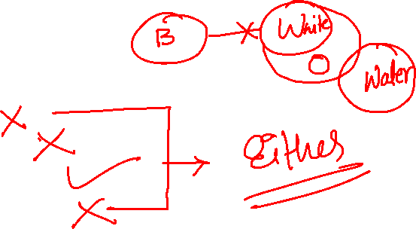
LOGICAL REASONING
SYLLOGISM
Q 31. Statements: No building is white.
All whites are oranges.
Some oranges are waters.
Conclusions: I. No building is water.
II. No orange is a building.
III. Some oranges are whites.
IV. Some waters are building.
Either I or IV and II follow
(2) Either I or IV and III follow
(3) Either I or IV follows
(4) None follows
(5) Either I or IV and II and III follow

Slide 74
LOGICAL REASONING
SYLLOGISM
Q 32. Statements: Some mangoes are apples.
Some bananas are apples.
Some branches are bananas.
Conclusions: I. Some mangoes are bananas.
II. Some branches are apples.
III. Some branches are mangoes.
IV. All apples are mangoes.
None follows
(2) Only I and II follow
(3) Only III and IV follow
(4) Only I and IV follow
(5) All follow

Slide 75
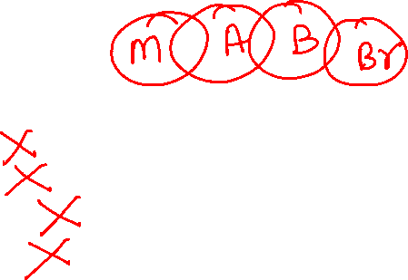
LOGICAL REASONING
SYLLOGISM
Q 32. Statements: Some mangoes are apples.
Some bananas are apples.
Some branches are bananas.
Conclusions: I. Some mangoes are bananas.
II. Some branches are apples.
III. Some branches are mangoes.
IV. All apples are mangoes.
None follows
(2) Only I and II follow
(3) Only III and IV follow
(4) Only I and IV follow
(5) All follow

Slide 76
LOGICAL REASONING
THANK YOU

